Slide 1

GeneX
Genetics made practical

Slide 2


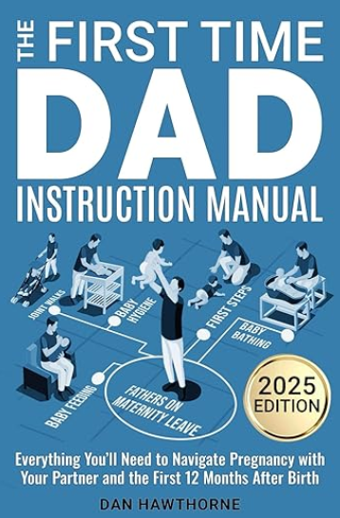




Typical guides fall short
There are many parenting books and guidelines on the market.
Notes:
Plot: the books fall over each other (stack of books), and make a stack of books.
Voice over: There are many parenting books and guidelines on the market

Slide 3


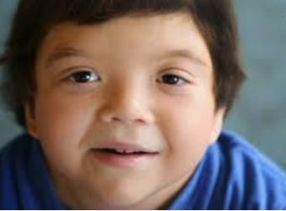
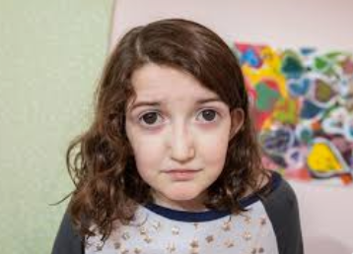
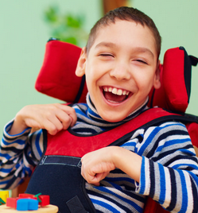

Typical guides fall short
But typical parenting milestones and guides don’t fit every child.
Specially for families of children with unique genetic conditions, neurodevelopmental disorders, neurological, sensory, and multifactorial conditions
These guides often stop just where the real journey begins.
Notes:
Plot: The photos of the kids appear one by one and stack of books appears at once after that a cross would come over the books (meaning those books are useless now)
Voice Over: But typical parenting milestones and guides don’t fit every child.
Specially for families of children with unique genetic conditions, neurodevelopmental disorders, neurological, sensory, and multifactorial conditions.
These guides often stop just where the real journey begins.

Slide 4
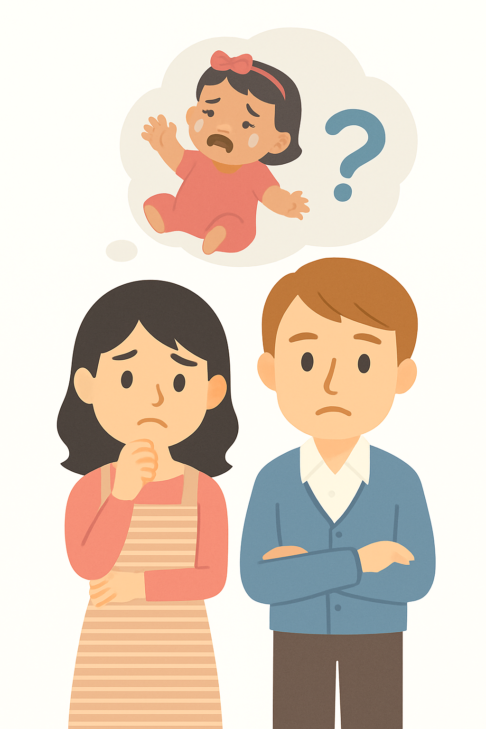





Meet Emma
When Emma was born, everything seemed fine.
But as months passed, her parents noticed she wasn’t sitting, crawling, or talking like other babies at the park.
They felt worried, lost, and unsure why milestones that fit every book didn’t fit their little girl.
Birth
2m
4m
6m
8m
10m
Notes:
Plot: milestone bar appears, and those milestones get added one by one
Voice Over: Emma was born with Down syndrome—a genetic condition that affects learning, speech, and muscle tone.
While other babies at the park were sitting, crawling, and talking, Emma was on her own timeline.
Her parents felt worried, lost, and overwhelmed by milestones that didn’t seem to fit their child.

Slide 5
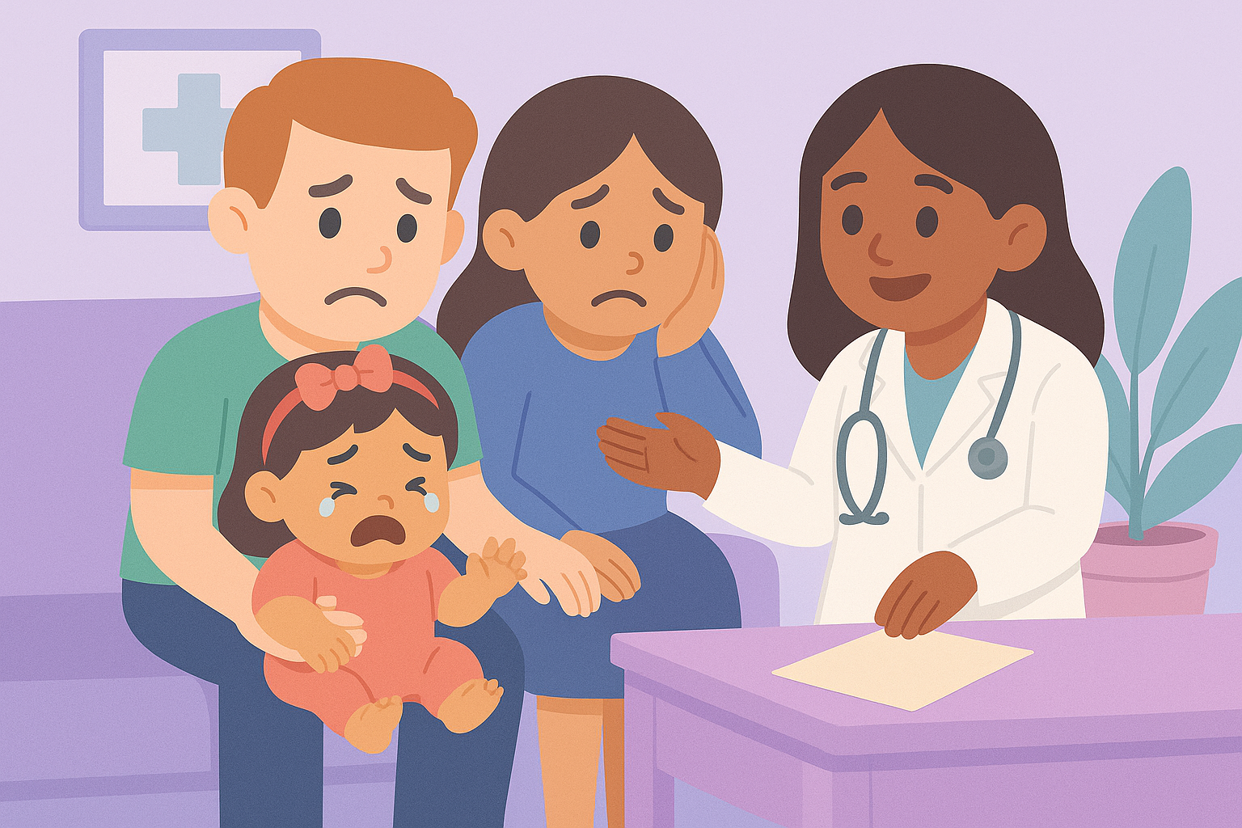
Diagnosis… then what?
After months of worry and endless appointments, Emma’s parents finally received an answer — Emma was diagnosed with Down syndrome, a genetic condition that affects learning, speech, and motor development.
The diagnosis brought clarity… but also uncertainty.
Once they left the doctor’s office, there was no roadmap — no plan for Tuesday’s therapy, or next month’s progress.
Notes:
Voice Over: Millions of families are navigating genetic or developmental conditions. Parents leave hospitals with a diagnosis—but no Tuesday plan.

Slide 6
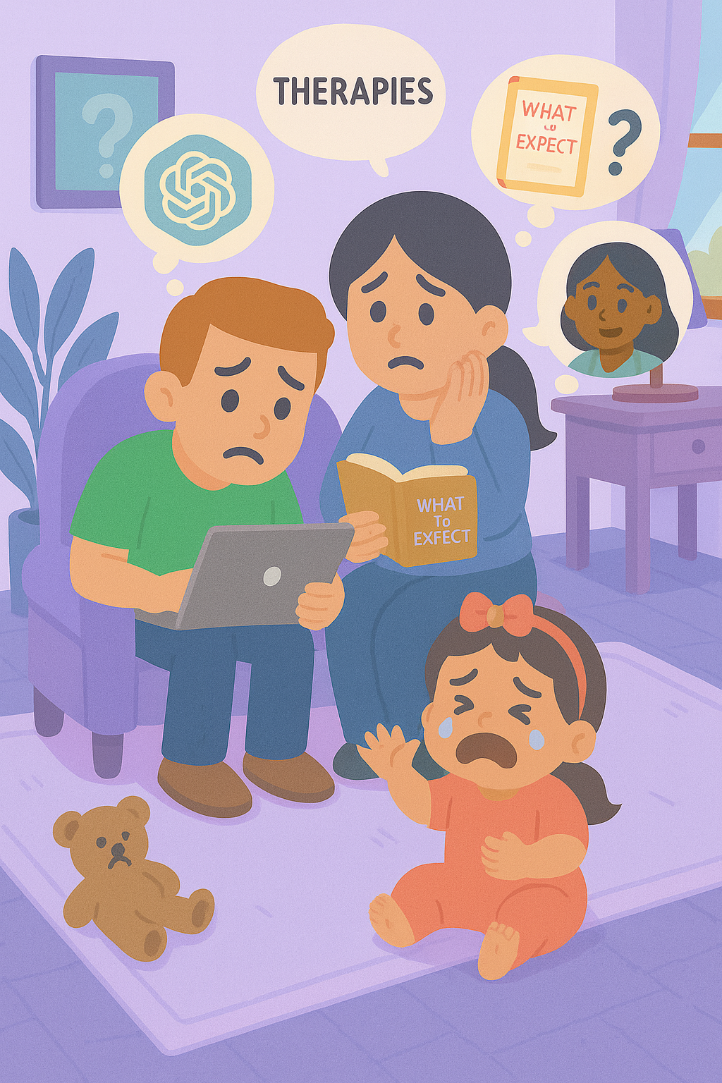
Diagnosis… then what?
Guidance is fragmented
Routines are hard to follow
and support often feels out of reach.
Notes:
Plot: The photo of family appears, then while the voice going over these three points, the icon and text for each one appears one by one.
Voice over: The guidance is fragmented, routines are hard to follow, and support often feels out of reach.

Slide 7

That’s why we built Genex

Slide 8



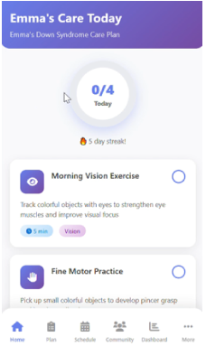


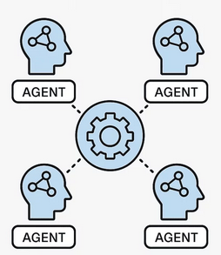





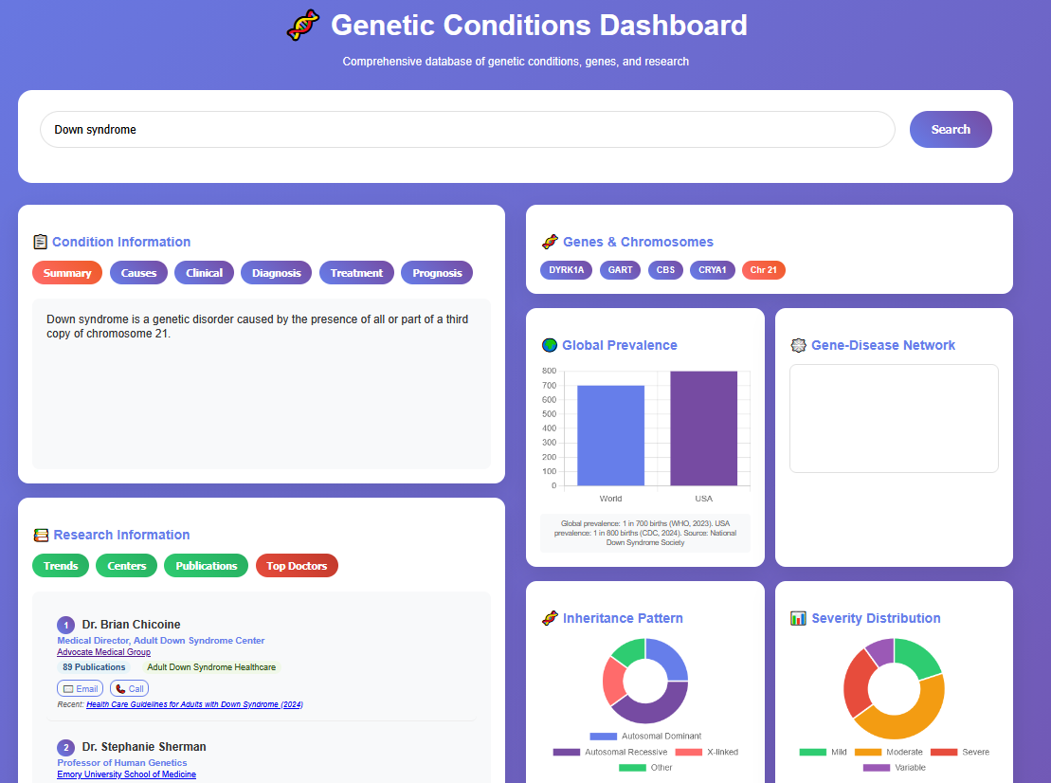

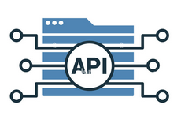


Genex – Technology
An AI care framework that learns with every family
Genex Core AI
Knowledge Graphs
Notes:
Plot: icons progress from left to write, all the data sources feed to the core AI model and core AI model creates the app and dashboard. And there would be a loop to feedback from app and dashboard to the core AI.
Voice over:
an AI framework that learns with every family.
Our platform brings together various data — such as books and research papers, clinical guidelines, and even family feedback.
Through a workflow engine, AI agents interpret complex genomic and clinical data — converting it into clear, actionable routines for everyday life . At our core AI, lies a biomedical knowledge graph — transforming fragmented data into insight. Our fine-tuned language models generate personalized care plans. Genex runs on micro-agents data lake architecture.
Our technology creates genex app as well as genex dashboard.
Privacy is woven into each and every layer and new evidence and every interaction — from new research, clinician feedback and family input — feeds back into our knowledge graph. With each loop, Genex grows smarter.

Slide 9
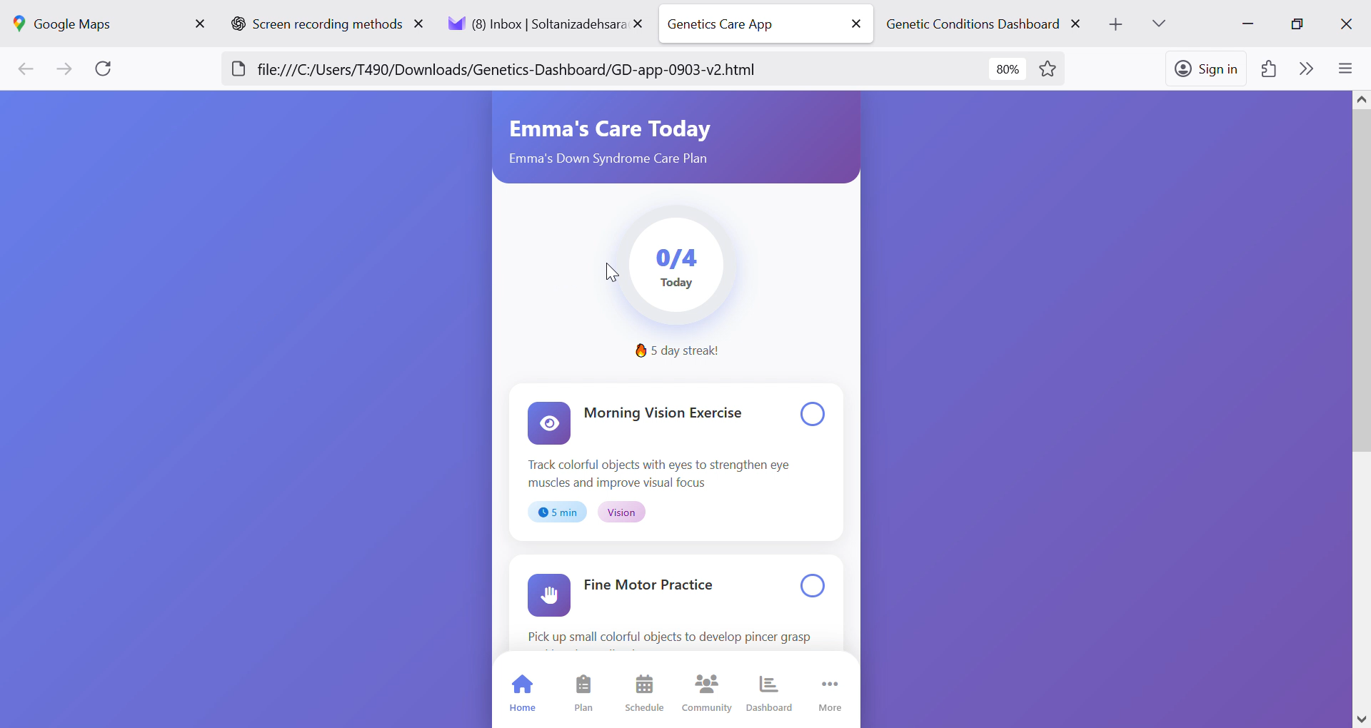
Introducing Genex – App
Free
Care plans
Curated daily 5–10 minutes activities
gentle reminders
progress tracking
community support
Notes:
Plot: The video plays and voice go over the voice over at the same time. The family doing daily activities drop one by one at the same time
Voice over: Introducing Genex App: Genex is a free app that offers care plans, curated, 5–10 minutes exercises, gentle reminders, progress tracking, and community support.

Slide 10
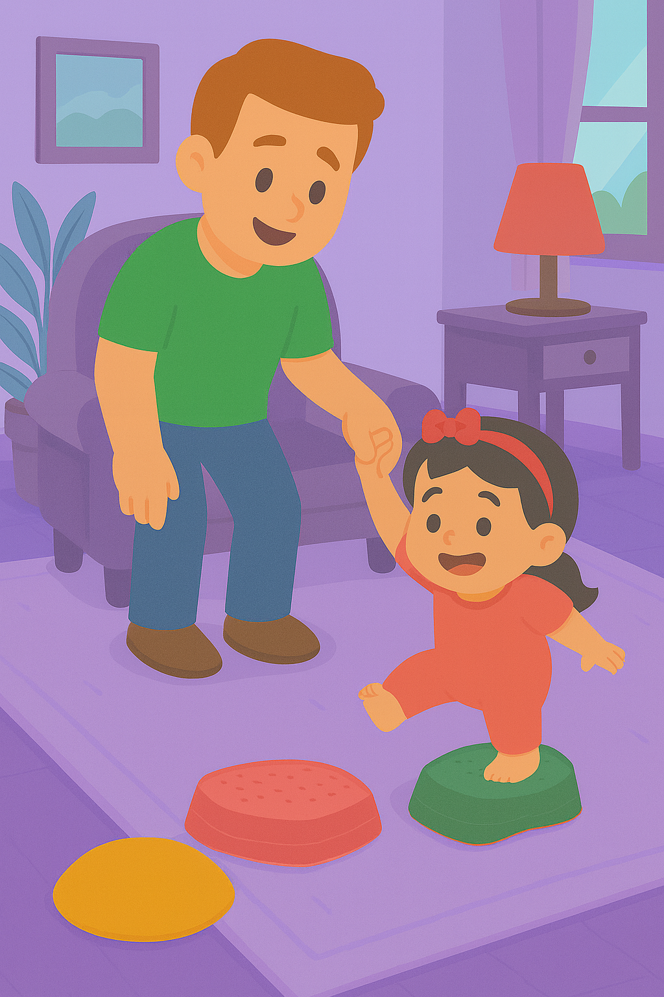
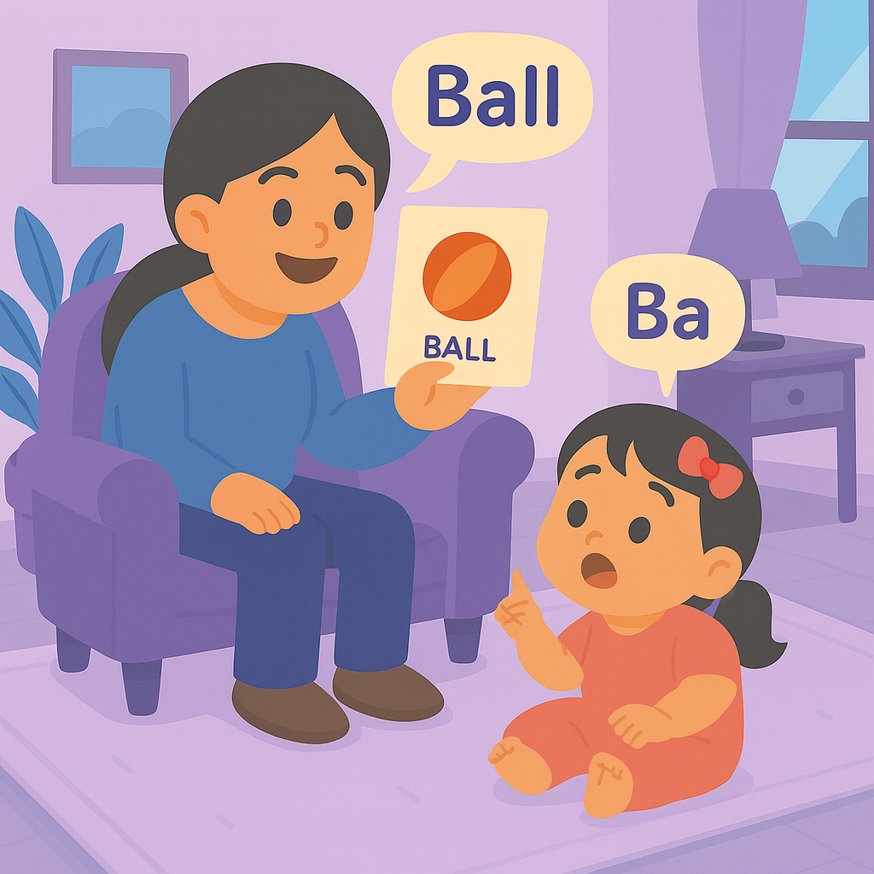
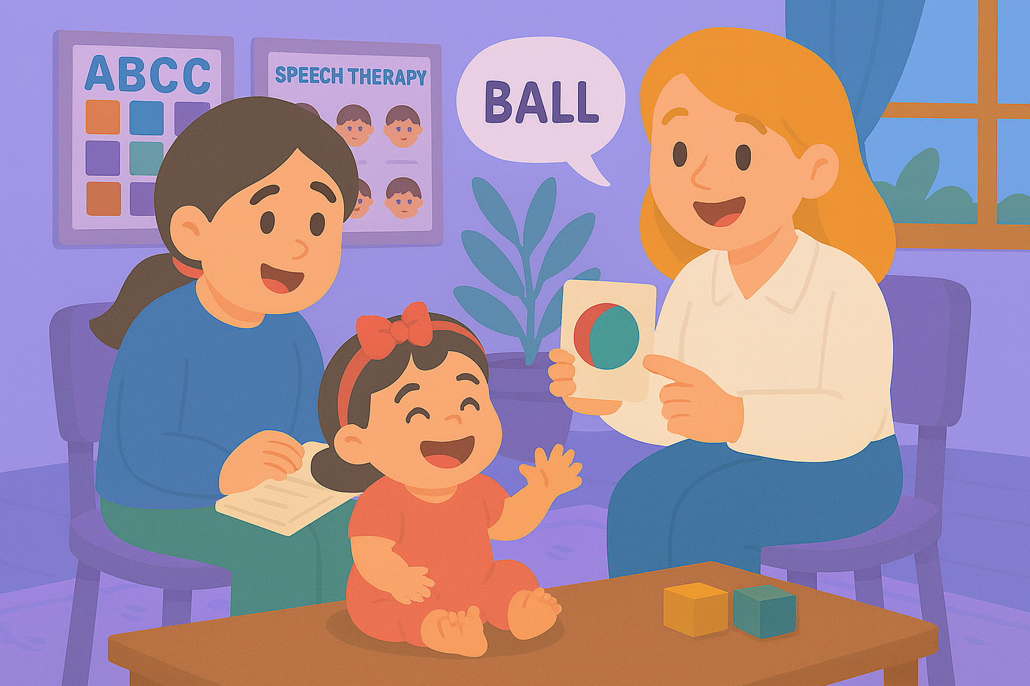
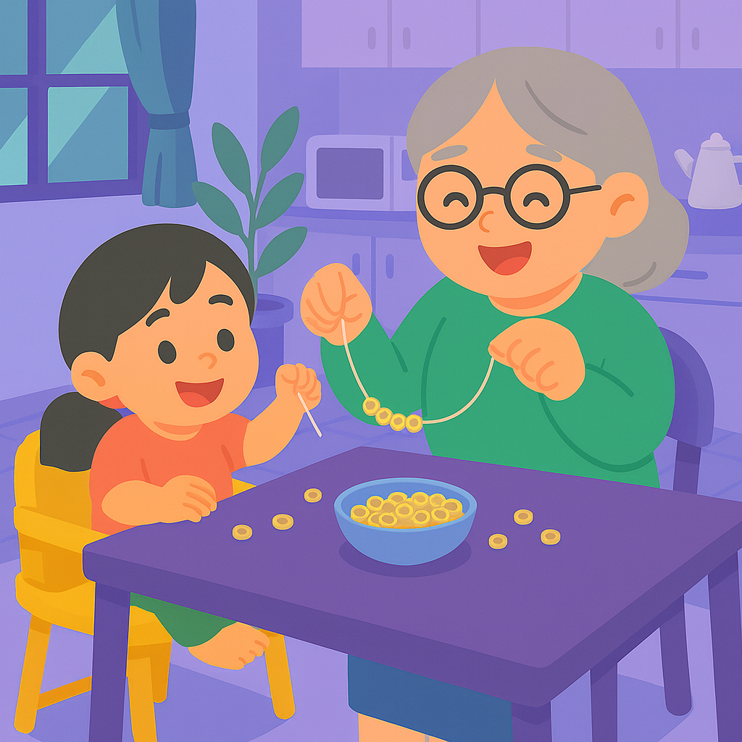
Genex – App
Helps:
families gain confidence
schools stay aligned
and children get consistent help - every day.
Notes:
Plot: The video plays and voice go over the voice over at the same time. The family doing daily activities drop one by one at the same time
Voice over: By using personalized plans and activities on genex App families gain confidence, schools stay aligned, and children get consistent help - every day.

Slide 11
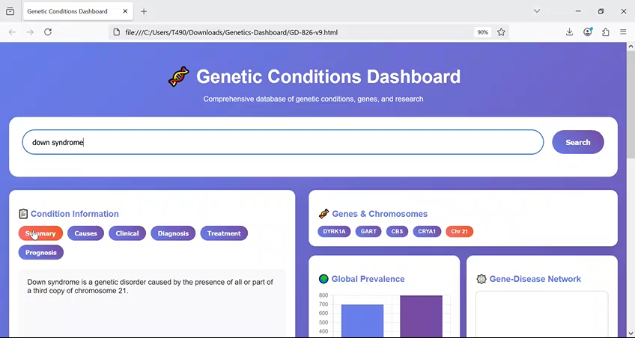
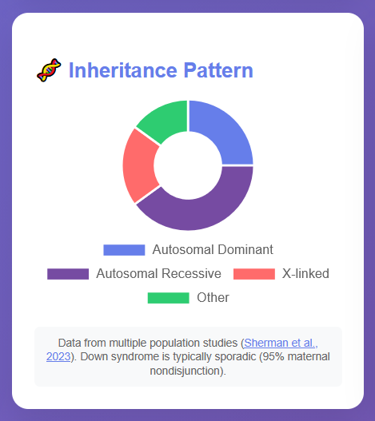
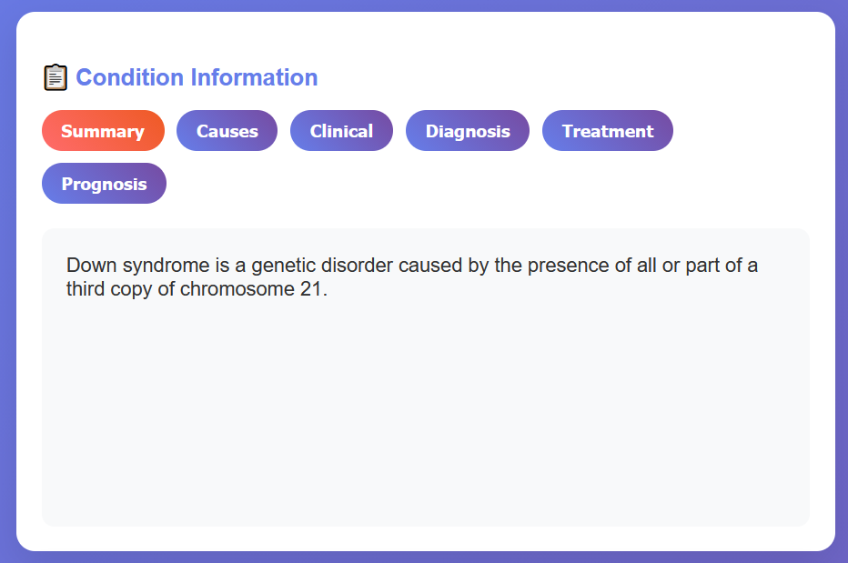
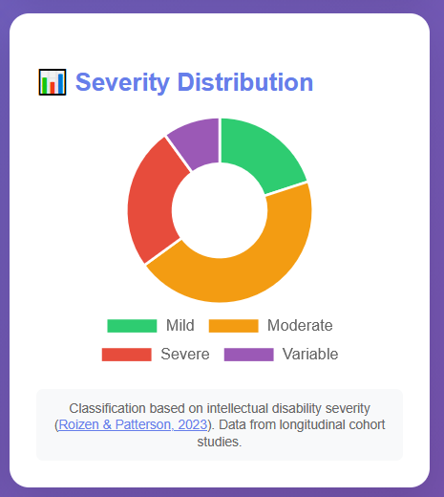
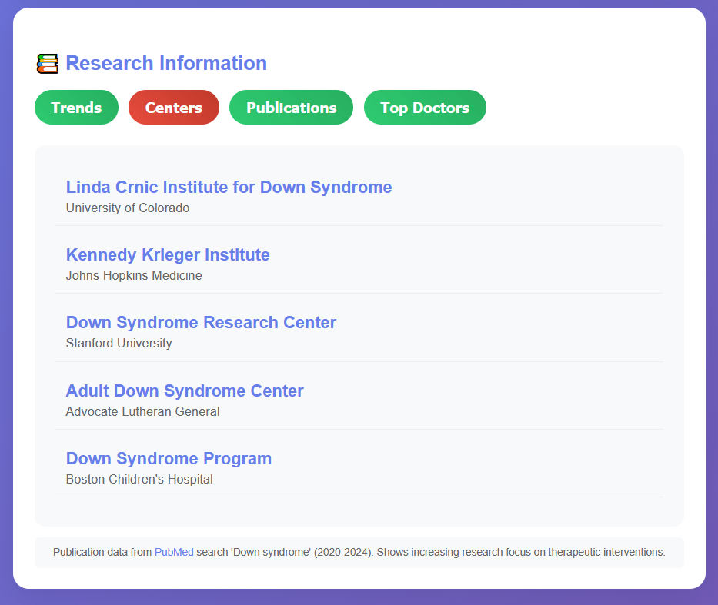
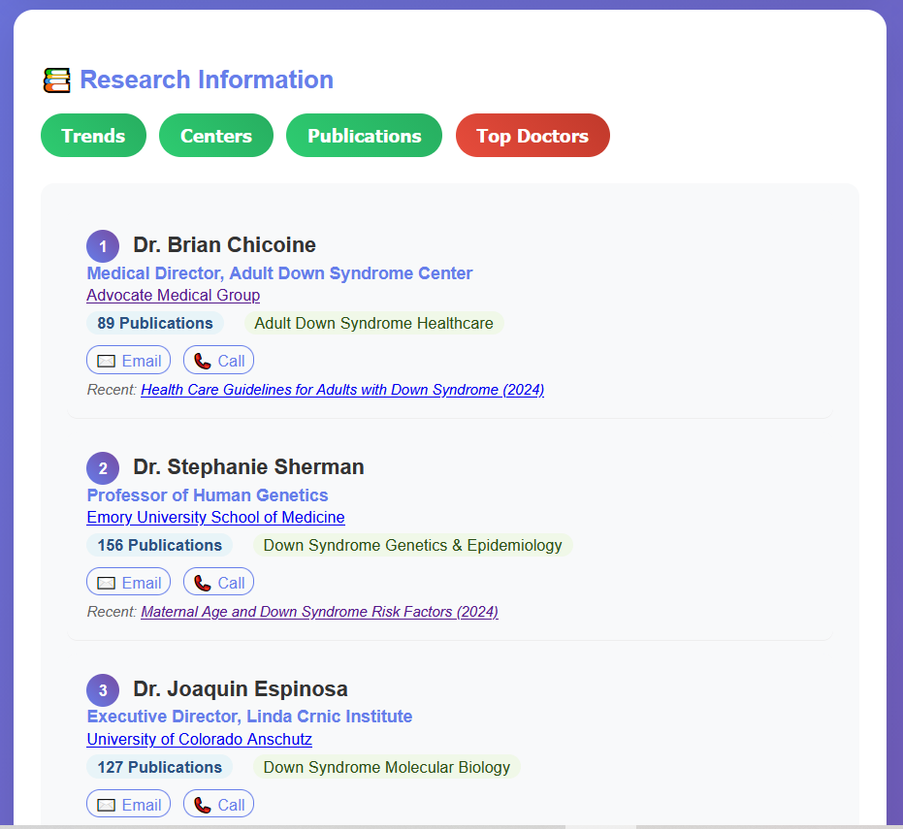
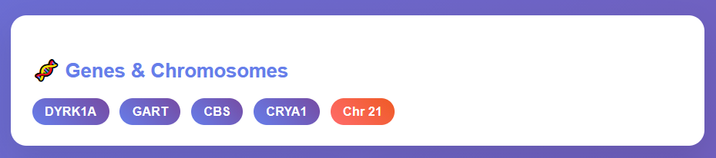
Introducing Genex – Dashboard
Offers:
Search and condition cards with source and confidence
At a glance visuals
Research lens including centers and top clinicians
Notes:
Plot: The video plays and voice go over the voice over at the same time. Need to zoom in every part of the dashboard when we are talking about it in the voice over
Voice over: With Genex you get access to it’s free, awesome dashboard that offers:
search and condition cards with source and confidence,
at a glance visuals,
and research lens, including centers and top clinicians.

Slide 12
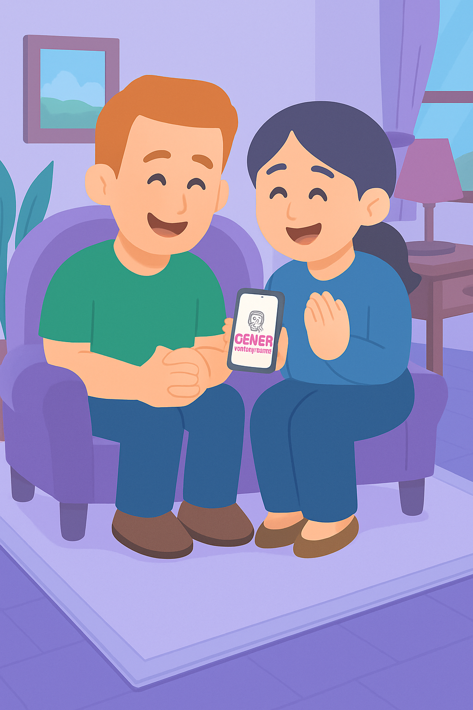
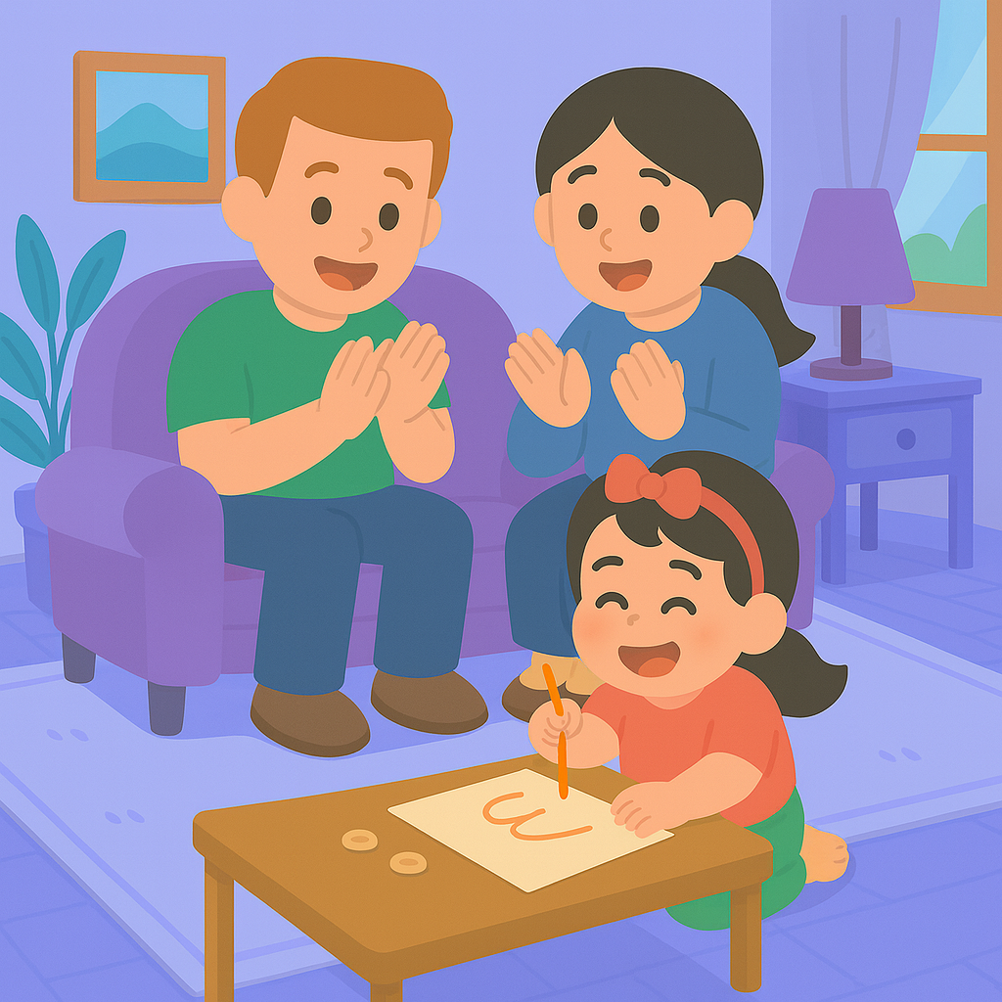
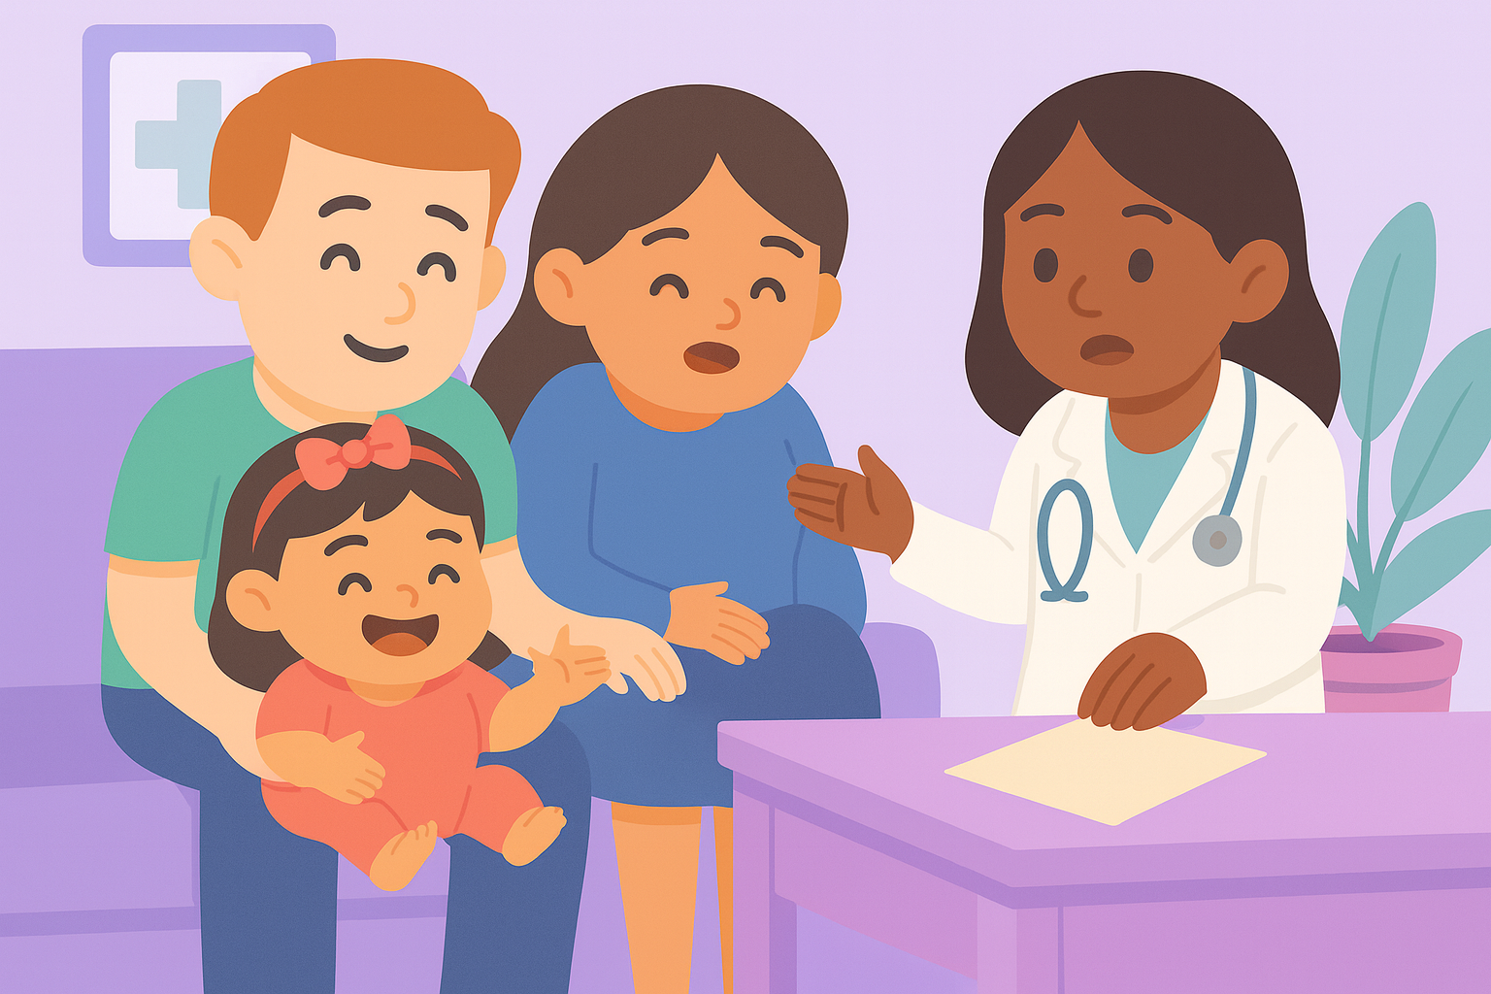
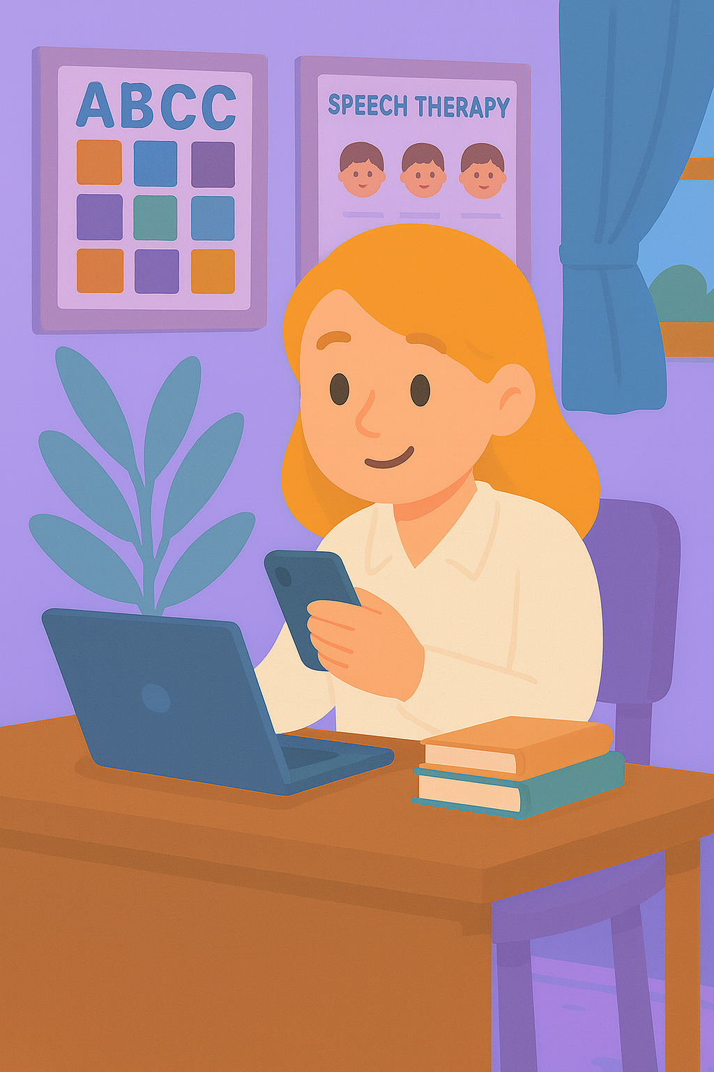
Genex – Dashboard
Helps:
Families understand their child’s situation better
Know what to ask their doctors
And providers to stay synched and give feeback.
Notes:
Voice over: Using the genex dashboard families understand their child’s situation better and know what to ask their doctors.
Genex Dashbord help providers to give feedback, modify the suggestions, and stay connected.

Slide 13
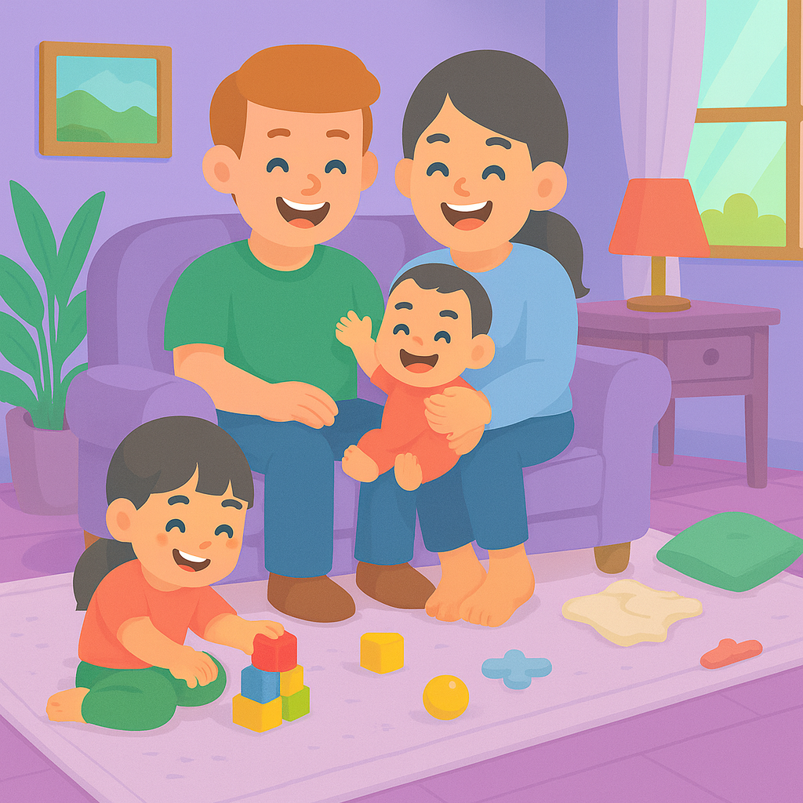
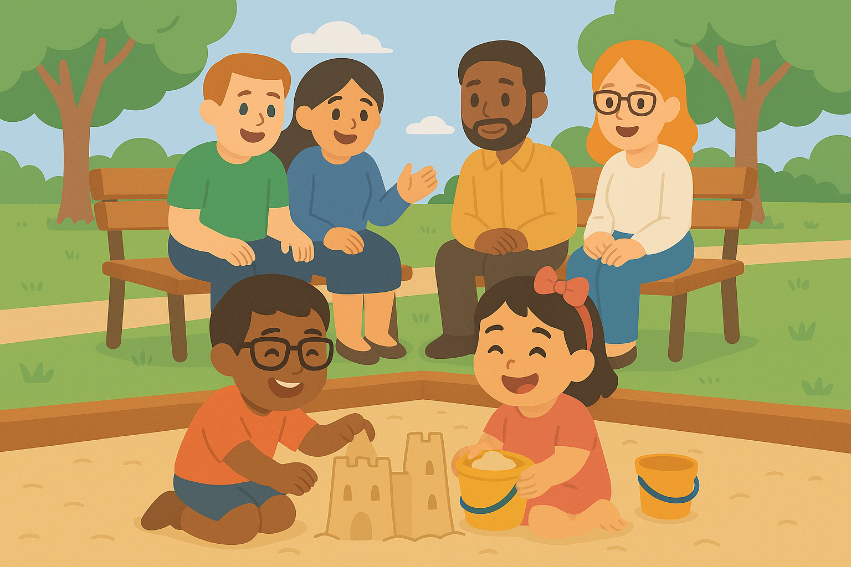
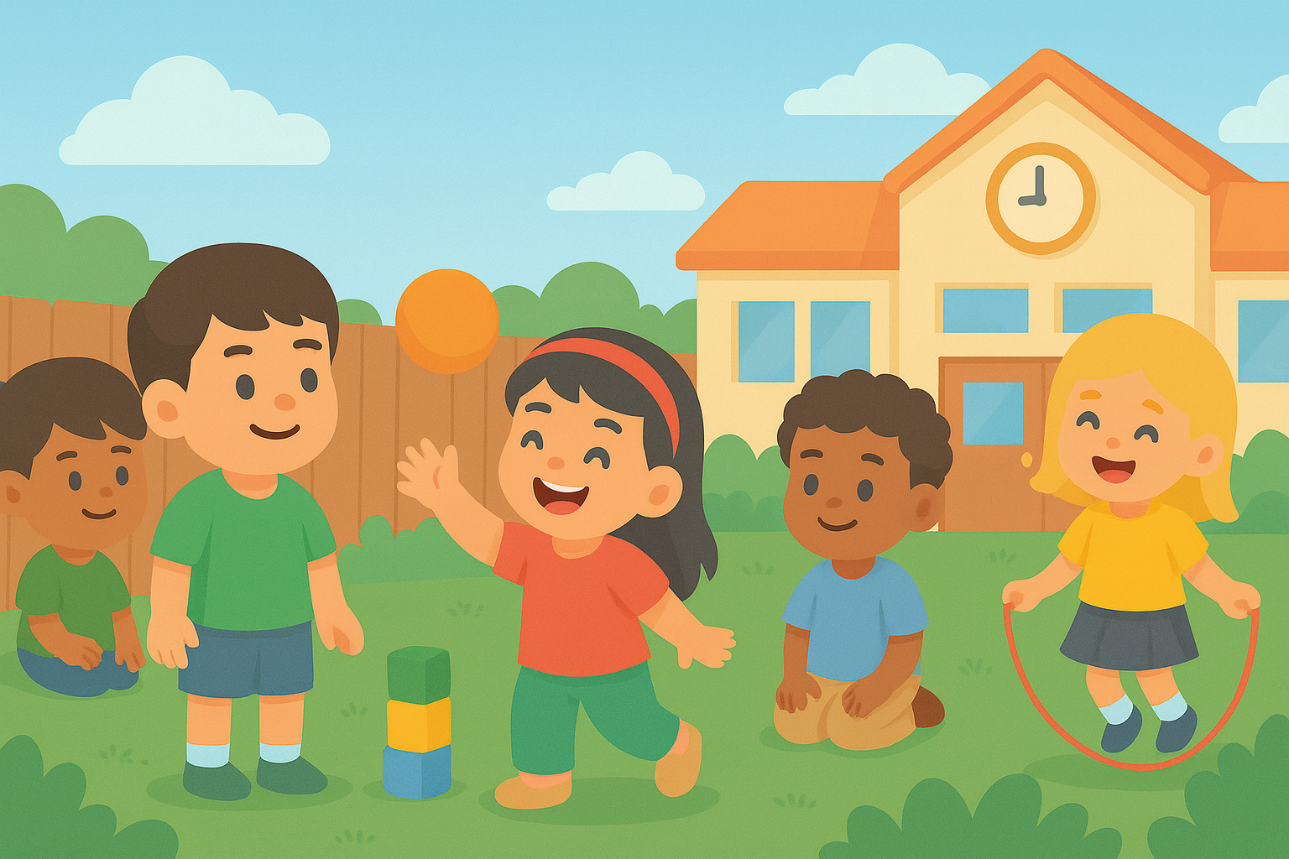
Together
Genex is where knowledge becomes care, and AI turns diagnosis into daily action.
Together we make care:
Simpler
Smarter
Supportive
Notes:
Plot: The video plays and voice go over the voice over at the same time.
Voice over: Genex is where knowledge becomes care, and AI turns diagnosis into daily action. Together, we make care simpler, smarter, and supportive.

Slide 14
GeneX
Genetics Made Practical
Notes:
Plot: The text come one word at a time, and then Genex logo appears.
Voice over: Genex, Genetics made practical.

Slide 15

Scan the QR code to try our free app and join our community!
By entering your email, you’ll be among the first to receive personalized support designed to help your child get the care they deserve.
Notes:
Plot: First the logo and QR code appear then, The text come one word at a time and voice read them.
Voice over: Scan the QR code to try our free app and join our community! By entering your email, you’ll be among the first families to receive personalized support designed to help your child get the care they deserve.

